Slide 1
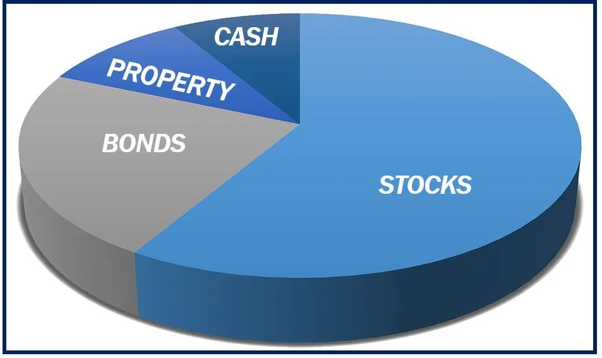
Lecture 6: Modern Portfolio Theory Ii
HE Tai-Sen
FINANCIAL ECONOMICS

Slide 2
Modern Portfolio Theory ll
Outline
Diversification (7.1)
Portfolios of Two Risky Assets (7.2)
Asset Allocation with Stocks, Bonds and Bills (7.3)
The Markowitz Portfolio Selection Model (7.4)
Experts’ Views on Diversification
Common Asset-Allocation Mistakes

Slide 3
Modern Portfolio Theory ll
Diversification
These situations differ in the budget constraint (i.e., portfolio opportunity set).
1 risk-free + 1 risky
2 risky
E(R)
E(R)
Std
Std
Notes:
Portfolio opportunity set shows all combinations of portfolio expected return and standard derivation that can be constructed from the two available assets.

Slide 4
Modern Portfolio Theory ll
Diversification
Example 1:
Two stocks: KMP and ABC
Portfolio X is composed of 40% in KMP and 60% in ABC.
State | Probability | KMP | ABC | Portfolio X
Boom | 30% | 18% | 0% | 7.20%
Neutral | 50% | 12% | 5% | 7.80%
Recession | 20% | -5% | 10% | 4.00%
E(r) |  | 10.40% | 4.50% | 6.86%
Std |  | 8.13% | 3.50% | 1.45%

Slide 5


Modern Portfolio Theory ll
Diversification
Example 2:
Two stocks: A (Ice Cream) and B (Umbrella)
Both stocks are selling at $100 per share.
 | Sunny (50%) | Rainy (50%)
 | 110 | 100
 | 100 | 110

Slide 6
Modern Portfolio Theory ll
Diversification
State of the Market | Probability | Year-end Price | Cash Dividends | HPR
Sunny | 50% | 110 | 0 | 10%
Rainy | 50% | 100 | 0 | 0%
E(A)= __%
Std(A)= __%
State of the Market | Probability | Year-end Price | Cash Dividends | HPR
Sunny | 50% | 100 | 0 | 0%
Rainy | 50% | 110 | 0 | 10%
E(B)= __%
Std(B)= __%
Notes:
5%; 5%; 5%; 5%

Slide 7
Modern Portfolio Theory ll
Diversification
What portfolio would you hold? ___ % in Stock A and ___% in Stock B
State of the Market | Probability | Year-end Price | Cash Dividends | HPR
Sunny | 50% | 105 | 0 | 5%
Rainy | 50% | 105 | 0 | 5%
E(X)= __%
Std(X)= __%

Slide 8
Modern Portfolio Theory ll
Diversification
Back to the graph,
2 risky assets
E(R)
Perfectly negatively correlated
Perfectly positively correlated
Std

Slide 9
Modern Portfolio Theory ll
Diversification
If you include additional securities in your portfolio (diversification strategy), you can stabilize portfolio return.
But, why end diversification with only two stocks? We can include more securities in the portfolio and portfolio volatility should continue to fall.
Risk
Unique risk (non-systematic risk, firm-specific risk)
e.g., CEO dies, factory fire
Market risk (systematic risk)
e.g., interest rate hikes
Number of stocks in the portfolio
Notes:
More examples of unique risk factors:
Sushiro:
https://www.youtube.com/shorts/37EfTuv3eWo
Cindi Wang’s performance on China Hunan TV
https://www.youtube.com/watch?v=te09w4vbQiY
https://www.youtube.com/watch?v=GnO6BbZrbko&t=38s

Slide 10
Modern Portfolio Theory ll
Portfolios of Two Risky Assets
Portfolio of Two Risky Assets:
Minimum variance portfolio
Optimal complete portfolio
E(r)
Std.

Slide 11
Modern Portfolio Theory ll
Portfolios of Two Risky Assets
Two risky assets: bond (D) and stock (E)
Notes:
Note: Cov (rD,rE)=Prob (scenario) (rD-E(rD)) (rE-E(rE))

Slide 12
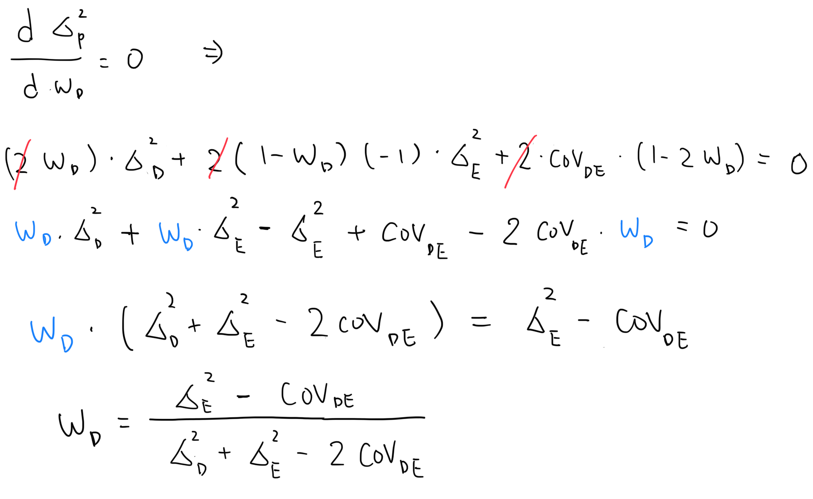
Modern Portfolio Theory ll
Portfolios of Two Risky Assets
Solving for the minimum variance portfolio
First-order condition:
Minimum variance portfolio:

Slide 13
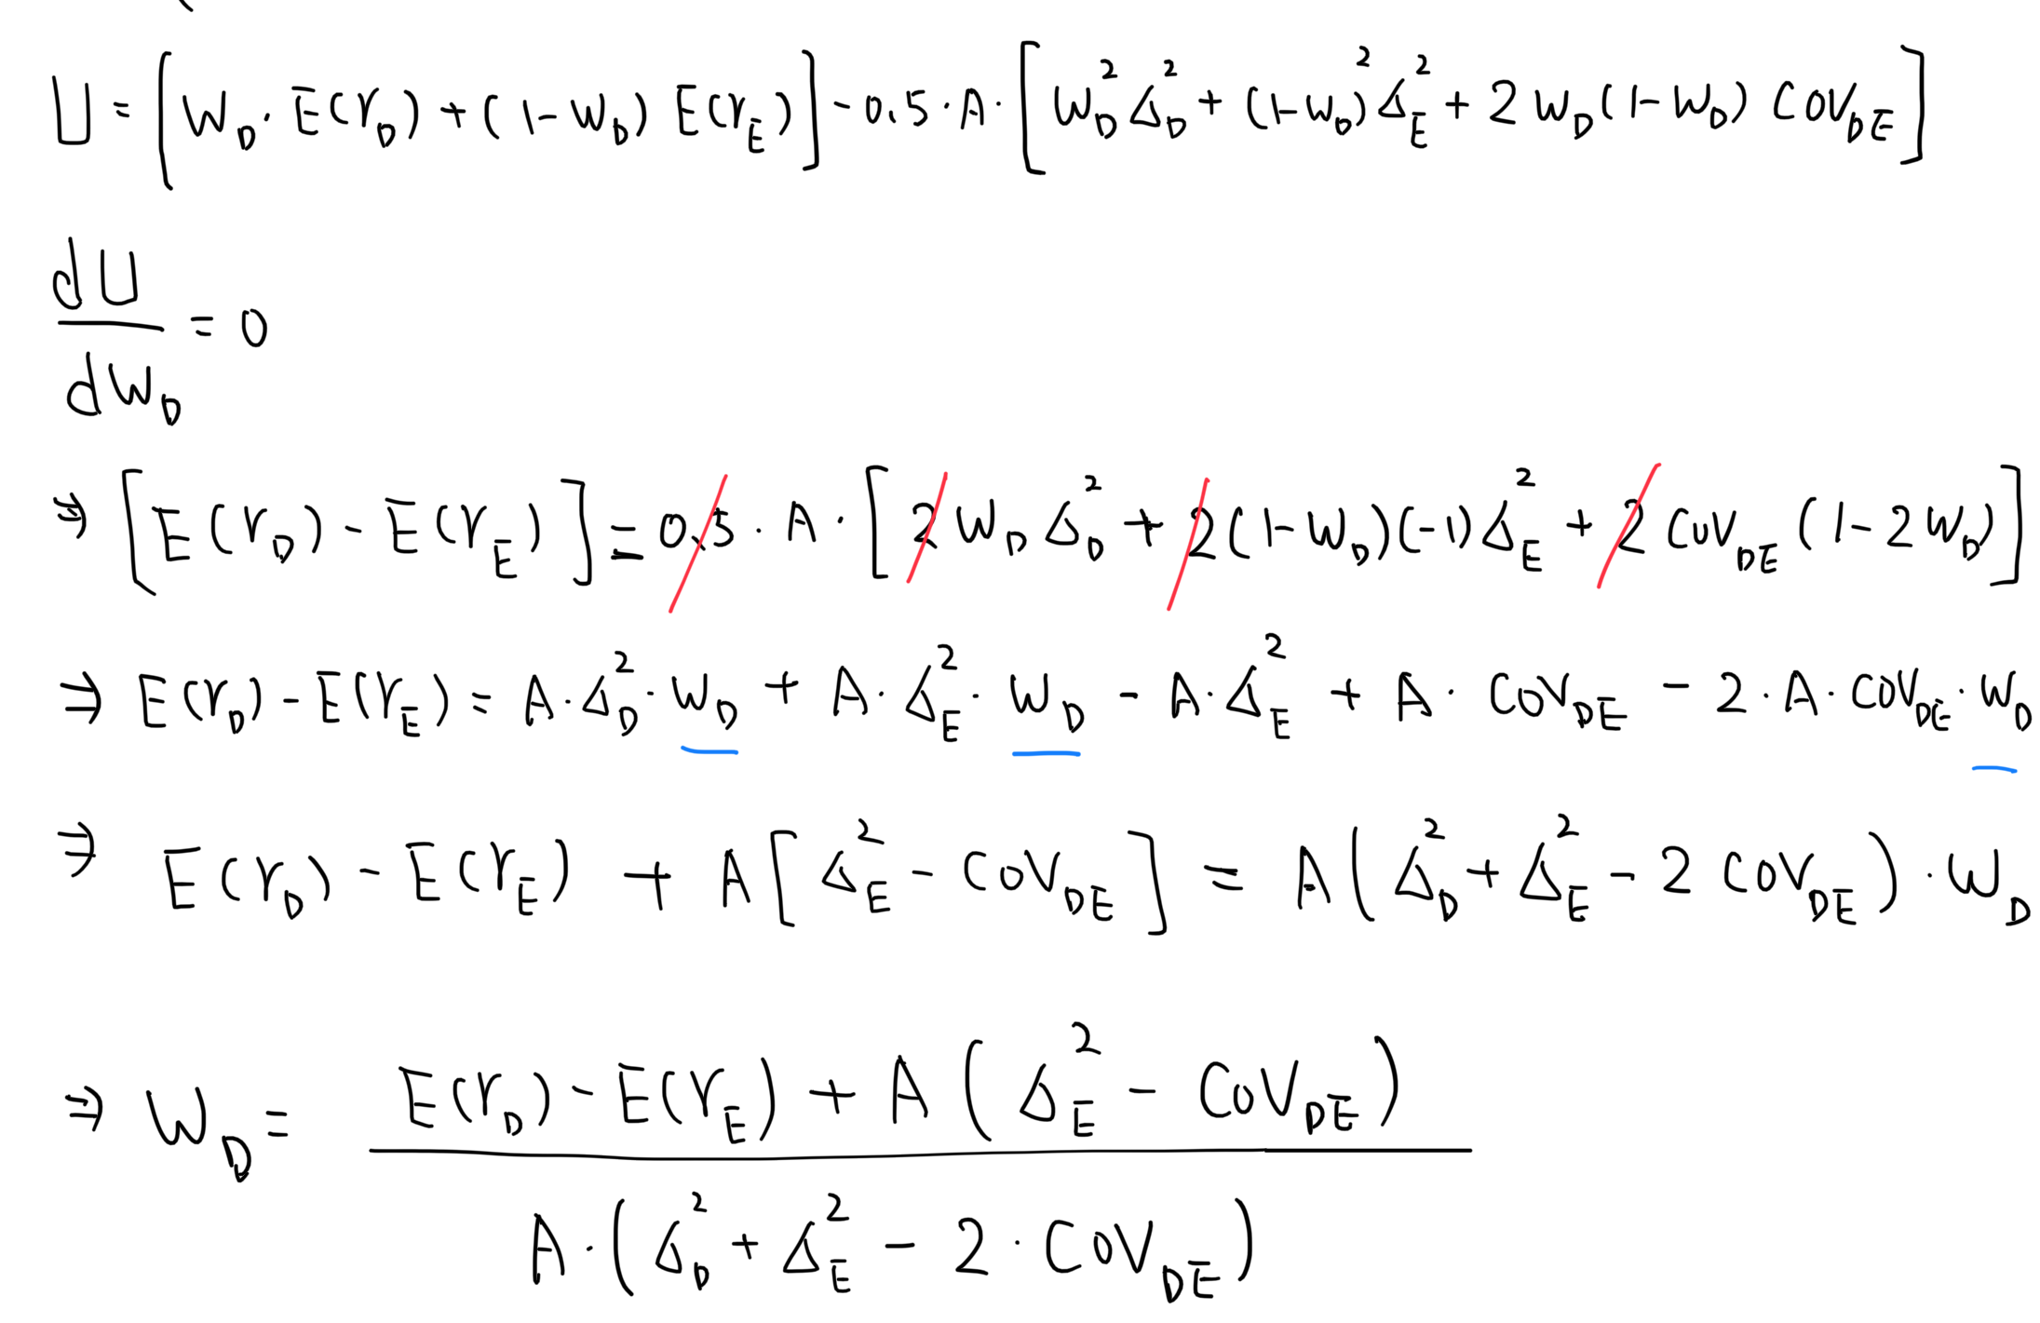
Modern Portfolio Theory ll
Portfolios of Two Risky Assets
Solving for the optimal complete portfolio (when there are two risky assets):
First-order condition:
Optimal complete portfolio:

Slide 14
Modern Portfolio Theory ll
Portfolios of Two Risky Assets
Numerical Example (refer to Table 7.1):
Minimum variance portfolio: W_{D}=82% W_{E}=18%
Optimal complete portfolio: W_{D}=50.75% W_{E}=49.25%
Assume A=4

Slide 15
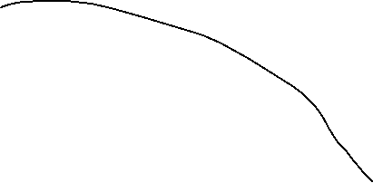

Modern Portfolio Theory ll
Asset Allocation with Stocks, Bonds and Bills
Suppose we have two risky assets and one risk-free asset. Again, we want to find the optimal complete portfolio.
Two steps:
Optimal risky portfolio
Optimal complete portfolio
E(r)
Std.

Slide 16
Modern Portfolio Theory ll
Asset Allocation with Stocks, Bonds and Bills
Step 1: Solving for optimal risky portfolio
E(r)
Best feasible CAL
Optimal risky portfolio
Std.

Slide 17
Modern Portfolio Theory ll
Asset Allocation with Stocks, Bonds and Bills
Notes:
RD=rD-rf

Slide 18
Modern Portfolio Theory ll
Asset Allocation with Stocks, Bonds and Bills
Step 2: Solving for optimal complete portfolio
E(r)
Best feasible CAL
Optimal complete portfolio
Std.

Slide 19
Modern Portfolio Theory ll
Asset Allocation with Stocks, Bonds and Bills
Step 2: Solving for optimal complete portfolio
In Lecture 4, you have learned that when there are one risky asset and one risk-free asset, the optimal complete portfolio is:

Slide 20
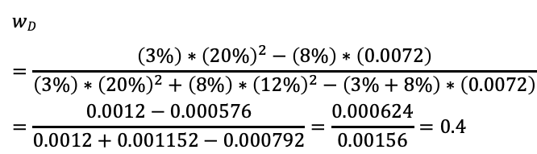
Modern Portfolio Theory ll
Asset Allocation with Stocks, Bonds and Bills
Numerical Example (assume A=4):
Optimal risky portfolio:
W_{D}=40% W_{E}=60%
Optimal complete portfolio:
E(r_{p})=11% Std_{p}=14.2%
$$wD=\frac{\left(3\%\right)∗{\left(20\%\right)}^{2}−\left(8\%\right)∗\left(0.0072\right)}{\left(3\%\right)∗{\left(20\%\right)}^{2}+\left(8\%\right)∗{\left(12\%\right)}^{2}−\left(3\%+8\%\right)∗\left(0.0072\right)}=\frac{0.0012−0.000576}{0.0012+0.001152−0.000792}=\frac{0.000624}{0.00156}=0.4$$
y*=(11%-5%)/4*(14.2%)²=74.39%
25.61% in T-bills, 44.63% in Equity; 29.76% in Debt

Slide 21
Modern Portfolio Theory ll
Asset Allocation with Stocks, Bonds and Bills
Separation Property: the portfolio choice problem may be separated into two independent tasks
Determine the optimal risky portfolio (objective)
Determine the optimal complete portfolio (subjective)

Slide 22
Modern Portfolio Theory ll
The Markowitz Portfolio Selection Model
The Markowitz Portfolio Selection Model (Many risky assets and one risk-free asset)
E(r)
Best feasible CAL
Efficient frontier
Std.

Slide 23
Modern Portfolio Theory ll
Experts’ Views on Diversification
Burton Malkiel’s view: Why Diversification Works?
Warren Buffet’s view: Diversification
Jack Bogle (Founder of Vanguard)’s 3 fund portfolio: Bogleheads 3 Fund Portfolio - The Ultimate Guide

Slide 24
Modern Portfolio Theory ll
Common Asset-allocation Mistakes
Asset allocation is the most important investment decision you will make.
Asset allocation explains 90% of the return earned while security selection explains 10%. (link)
Many investors suffer from two common allocation sins: being too conservative and/or poorly diversified. (link)
Being too conservative often comes in the form of too much cash and bonds and not enough stocks (more on cash in the next section). The consequence of being too conservative too soon could be running out of money. (An economist’s story)
A properly diversified stock portfolio, for instance, should have exposure to all economic sectors. You should also aim for exposure across different styles, sizes, regions, and to the extent possible, sub-industries. Spread out your risk. Doing this reduces portfolio volatility and can actually improve expected return.

